Slide 1
Amazon Sales Data Report

Slide 2
Problem Statement:
Sales management has gained importance to meet increasing competition and the need for improved methods of distribution to reduce cost and to increase profits. Sales management today is the most important function in a commercial and business enterprise. Do ETL: Extract-Transform-Load some Amazon dataset and find for me Sales-trend -> month-wise, year-wise, yearly month-wise Find key metrics and factors and show the meaningful relationships between attributes. Do your own research and come up with your findings

Slide 3
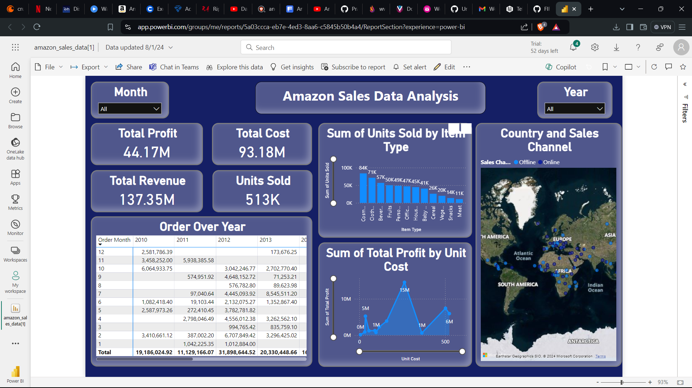

Slide 4
Thank You
Name- Yash Gautam
E-mail- yashr7143@gmail.com

